Slide 1
Varenicline as a Smoking Cessation Tool for Long-Term Recovery
February 24, 2022 l 2:30 – 3:30 pm ET
Notes:
Good afternoon, everyone and welcome to today’s webinar “Varenicline as a Smoking Cessation Tool for Long-Term Recovery”.

Slide 2
Welcome!
Tamanna Patel, MPH
Director,
Practice Improvement
Samara Tahmid
Project Manager,
Practice Improvement
Hope Rothenberg
Project Coordinator,
Practice Improvement
Notes:
On behalf of the National Council for Mental Wellbeing, welcome again and thank you for joining us today! My name is Hope Rothenberg, Project Coordinator and I will be serving as your moderator for today’s webinar. Also on the line are my colleagues, Tamanna Patel, Director of Practice Improvement and Samara Tahmid, Project Manager of Practice Improvement.

Slide 3
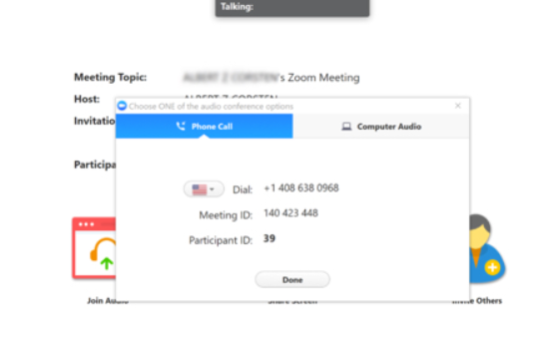
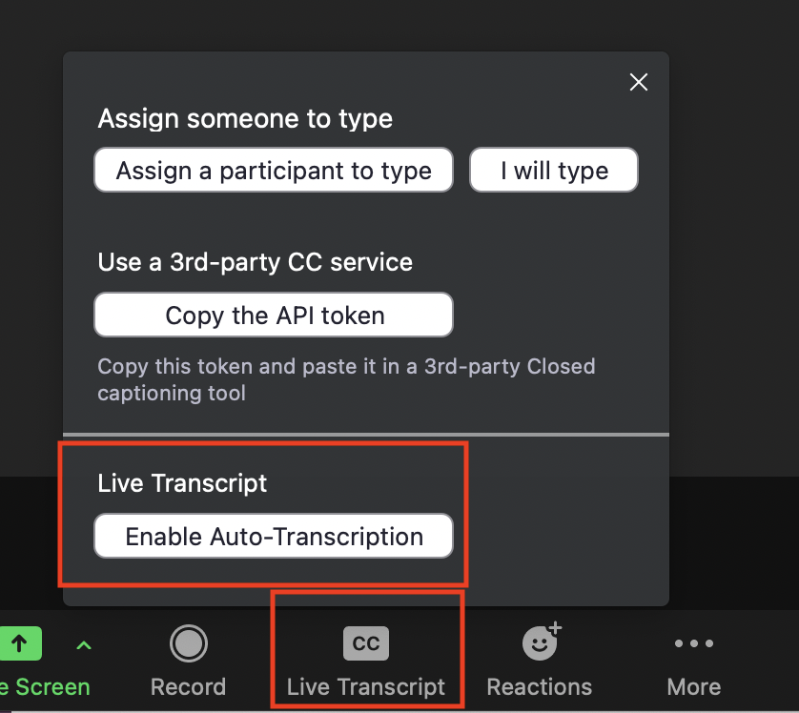
Housekeeping
This workshop is being recorded. All participants are placed in “listen-only” mode.
For audio access, participants can either dial into the conference line or listen through your computer speakers.
Submit questions by typing them into the chat box or using the Q&A panel.
Slide handouts and recording will be posted here:
https://www.bhthechange.org/resources/improving-lung-health-and-mental-wellbeing-during-covid-19/
Access closed captioning by enabling live transcript.
Notes:
First, I would like to go over some housekeeping items. Today’s webinar IS being recorded and all participants will be kept in listen only mode. You can access audio for today’s presentation by dialing in on your telephone or listening through your computer speakers. Questions may be submitted throughout the webinar by typing your question into the chat box or using the Q&A panel on your zoom dashboard. We will have a PDF copy of the webinar slides available for download on our website following today’s presentation. Closed captioning for this webinar can be accessed by enabling live transcription as shown on the right of the screen. A brief survey will pop up following the webinar so please don’t forget to take a few moments to let us know how we did!

Slide 4
National Behavioral Health Network for Tobacco & Cancer Control
Jointly funded by CDC’s Office on Smoking & Health & Division of Cancer Prevention & Control
Provides resources and tools to help organizations reduce tobacco use and cancer among individuals experiencing mental health and substance use challenged
1 of 8 CDC National Networks to eliminate cancer and tobacco disparities in priority populations
Visit www.BHtheChange.org and Join Today!
Free Access to…
Toolkits, training opportunities, virtual communities and other resources
Webinars & Presentations
State Strategy Sessions
Communities of Practice
#BHthechange
Notes:
Now, I’d like to provide a brief overview of the National Behavioral Health Network for Tobacco & Cancer Control, part of the National Council for Mental Wellbeing and otherwise known as NBHN. NBHN is 1 of 8 CDC National Networks committed to eliminating tobacco and cancer-related disparities and advancing health equity for all. Through NBHN, we provide webinars like today’s, communities of practice, and many other resources all focused on addressing tobacco and cancer-related disparities for individuals experiencing mental health and substance use challenges,
Please visit www.BHtheChange.org to join the Network for free and gain direct access to helpful resources.

Slide 5
Today’s Featured Speaker
Chad Morris, Ph.D.
Professor of Psychiatry
Director, Behavioral Health & Wellness Program
University of Colorado, Anschutz Medical Campus
Notes:
Now It’s my pleasure to introduce today’s featured speaker, Chad Morris, Ph.D., Professor of Psychiatry and Director of the Behavioral Health and Wellness Program at University of Colorado An-shoots Medical Campus. Chad?

Slide 6
Disclosure
Site Principal Investigator for Pfizer Varenicline Clinical Trials:
Smokers with and without Psychiatric Disorders (EAGLES A3051123-A3051148) - 2011-2014
Smokers with Depression (A3051122) - 2010-2012
Persons with Psychotic Disorders (A3051072) - 2008-2009

Slide 7
Explore
the role of FDA-approved pharmacological treatments for cessation
Learn
about the benefits of varenicline as a first-line cessation medication
Examine
the evidence base regarding using varenicline in combination with other cessation medications and behavioral strategies.
Gain
practical tools to initiate conversations about varenicline

Slide 8
61-90% Schizophrenia
38-42% ADHD
36-80% Major Depression
32-60% Anxiety
51-70% Bipolar Disorder
49-80% Other Drug Abuse
34-80% Alcohol Abuse
45-60% PTSD
13.7% of adults are current smokers
Notes:
Training Notes:
This graph depicts the change in smoking rates for men and women from 1955-2013 (USDHHS, 1979; American Lung Association, 2011; CDC, 2012; Agaku et al., 2014a; Agaku et al., 2014b; Jamal et al., 2014; Jamal et al., 2015, Creamer et al., 2019).

Slide 9
Medication Assisted Treatment
Combination of behavioral interventions and medications
Highly effective treatment option for alcohol, opioid, or tobacco dependence
Reduces illicit drug use and overdose deaths

Slide 10
Treatment Effectiveness
Treatment Format | Abstinence Rate
Unaided | 4-7%
Self-help | 11-14%
Quitline | 11-15%
Individual counseling | 15-19%
Group counseling | 12-16%
Medication alone | 22%
Medication + counseling | 25-30%
Clinical Practice Guideline Treating Tobacco Use and Dependence 2008
Notes:
Training Notes:
Research shows that tobacco cessation treatment works (Fiore et al., 2008).
Clinical Practice Guideline Treating Tobacco Use and Dependence 2008 Update Panel, Liaisons, and Staff. A clinical practice guideline for treating tobacco use and dependence: 2008 update. A U.S. Public Health Service report. Am J Prev Med. 2008 Aug;35(2):158-76. doi: 10.1016/j.amepre.2008.04.009. PMID: 18617085; PMCID: PMC4465757.

Slide 11
Tobacco Cessation Medications
The only medications approved by the Food and Drug Administration (FDA) for tobacco cessation are:
Nicotine patch
Nicotine gum
Nicotine lozenge
Nicotine nasal spray
Nicotine inhaler
Bupropion SR tablets
Varenicline tablets

Slide 12
Dopamine Reward Pathway
Prefrontal cortex
Dopamine release
Stimulation of nicotine receptors
Nucleus accumbens
Ventral tegmental area
Nicotine enters brain

Slide 13
Varenicline Tartrate
Selective α4β2 nicotinic acetylcholine receptor (nAChR)receptor partial agonist. It works in two ways:
It acts like nicotine in the brain but does not have as strong of an effect.
It blocks the places in the brain where nicotine would normally work.
Initial dosing is 0.5 mg/day for 3 days and then twice daily for 4 days. For next 11 weeks, dosing is 1 mg twice daily

Slide 14
Varenicline: Side Effects & Precautions
Side effects include:
Nausea
Headache
Insomnia and abnormal dreams
Constipation and flatulence
Precautions for individuals:
Operating heavy machinery
With kidney or cardiac problems
Taking insulin, asthma medications, or blood thinners

Slide 16
Black Box Warning
2009
Black box added due to concern about possible neuropsychiatric effects such as depressed mood, suicidality, aggression and cardiovascular adverse effects such as nonfatal myocardial infarction
2015
Additional label warnings concerning possible reaction to alcohol and the reports of seizures
2016
Black box removed following EAGLES trial outcomes

Slide 17
Effectiveness of Varenicline

Slide 18
Numbers Needed to Treat Cochrane Review
Intervention | NNT | Impact on Patient
CHANTIXTM vs placebo | 8
Bupropion SR vs placebo | 15
NRT vs placebo | 20
Interpretation of NNT: CHANTIXTM therapy accounts for 1 additional quitter for every 8 patients treated; having the lowest # of patients needed to treat in order to gain 1 quitter.
Cahill K et al. The Cochrane Library. 2007.
Notes:
18
Reference
Cahill K, Stead LF, Lancaster T. Nicotine receptor partial agonists for smoking cessation. Cochrane Database of Systematic Reviews. 2007, Issue 1. Art. No.: CD006103. DOI: 10.1002/14651858.CD006103.pub2.
Cahill/6/1/3/1-3, 9-10, 13-16
Ref 1/ Cahill/6/1/3/ 9-10
Ref 1 Cahill/6/1/3/13-16

Slide 19
Pharmacotherapy Efficacy
Abstinence rates compared to placebo at 6-months or greater post-quit
Medication | Number of Trials (People) | Estimated Risk Ratio
NRT | 133 (64,640) | 1.6 (1.5-1.6)
Bupropion | 46 (17,866) | 1.6 (1.5-1.8)
Varenicline | 27 (12,625) | 2.2 (2.1-2.4)
(Cahill et al., 2016; Hartmann-Boyce et al., 2018; Howes et al., 2020)
Notes:
Training Notes:

Slide 20
Design: Prospective, randomized, double-blind, 24-week trial
Treatments: Varenicline, bupropion, NRT patch, placebo
Duration: 12 weeks treatment: 12 weeks non-treatment follow-up
Sample Size: 8,144 randomized participants (4,116 to the psychiatric cohort and 4,028) without psychiatric disorder
EAGLES Study Design
Anthenelli et al., 2016
Notes:
Anthenelli RM, Benowitz NL, West R, St Aubin L, McRae T, Lawrence D, Ascher J, Russ C, Krishen A, Evins AE. Neuropsychiatric safety and efficacy of varenicline, bupropion, and nicotine patch in smokers with and without psychiatric disorders (EAGLES): a double-blind, randomised, placebo-controlled clinical trial. Lancet. 2016 Jun 18;387(10037):2507-20. doi: 10.1016/S0140-6736(16)30272-0. Epub 2016 Apr 22. PMID: 27116918.

Slide 21
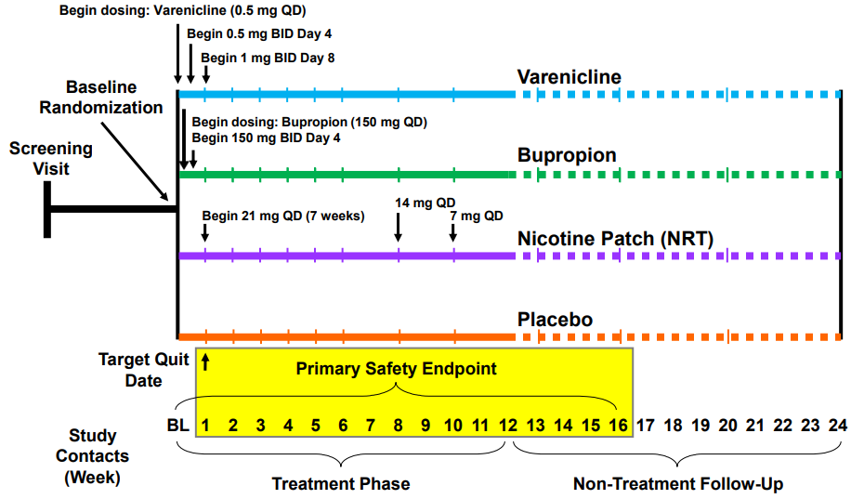
EAGLES Study Design
Vertical ticks represent subject clinic visits
BID=Twice Daily: BL=Baseline; QD=once Daily
Anthenelli et al., 2016
Notes:
Anthenelli RM, Benowitz NL, West R, St Aubin L, McRae T, Lawrence D, Ascher J, Russ C, Krishen A, Evins AE. Neuropsychiatric safety and efficacy of varenicline, bupropion, and nicotine patch in smokers with and without psychiatric disorders (EAGLES): a double-blind, randomised, placebo-controlled clinical trial. Lancet. 2016 Jun 18;387(10037):2507-20. doi: 10.1016/S0140-6736(16)30272-0. Epub 2016 Apr 22. PMID: 27116918.

Slide 22
Effectiveness: EAGLES
Efficacy- Evaluate CO-confirmed continuous abstinence rate for weeks 9-12 and 9-24 as a function of treatment, psychiatric disorder and the interaction of treatment and psychiatric disorder.
Interpretation- Varenicline was more effective than placebo, nicotine patch, and bupropion in helping smokers achieve abstinence, whereas bupropion and nicotine patch were more effective than placebo.
Anthenelli et al., 2016

Slide 23
Effectiveness: Prospective Cohort Study
Design- Electronic Medical Records from 654 practices
Sample- 235,314 (159,736 NRT; 75,578 varenicline)
Interpretation- Triangulating evidence across three analytical approaches, varenicline was more effective than NRT for smoking cessation in patients with mental disorders.
(Taylor et al., 2020)
Notes:
Taylor GMJ, Itani T, Thomas KH, et al. Prescribing Prevalence, Effectiveness, and Mental Health Safety of Smoking Cessation Medicines in Patients With Mental Disorders. Nicotine Tob Res. 2020;22(1):48-57. doi:10.1093/ntr/ntz072

Slide 24
Effectiveness: Systemic Reviews and Meta-Analyses
Design- Systematic reviews and Bayesian network meta-analyses of RCTs, in any setting, of varenicline, bupropion, NRT and e-cigarettes
Sample- 363 trials for effectiveness and 355 for safety
Interpretation- monotherapy with varenicline increased cessation compared to bupropion and to NRT, while finding inconclusive evidence of a difference in quitting between bupropion and NRT
Thomas et al., 2021
Notes:
Thomas KH, Dalili MN, López-López JA, Keeney E, Phillippo DM, Munafò MR, Stevenson M, Caldwell DM, Welton NJ. Comparative clinical effectiveness and safety of tobacco cessation pharmacotherapies and electronic cigarettes: a systematic review and network meta-analysis of randomized controlled trials. Addiction. 2021 Oct 11. doi: 10.1111/add.15675. Epub ahead of print. PMID: 34636108.

Slide 25
Effectiveness: Combined Pharmacotherapy
Thomas et al., 2021- Findings were consistent for combined varenicline + NRT, which showed improved probability of quitting compared to bupropion and NRT monotherapies
Leone et al., 2020 - Conditional recommendation for combining a nicotine patch with varenicline rather than using varenicline alone

Slide 26
Safety of Varenicline

Slide 27
Types of Adverse Events
Major adverse cardiovascular events (MACEs)
Serious adverse events(SAEs)
death, life-threatening, required hospitalization or resulted in significant disability
Major adverse neuropsychiatric events (MANEs)
suicide, attempted suicide, suicidal ideation, depression, seizures

Slide 28
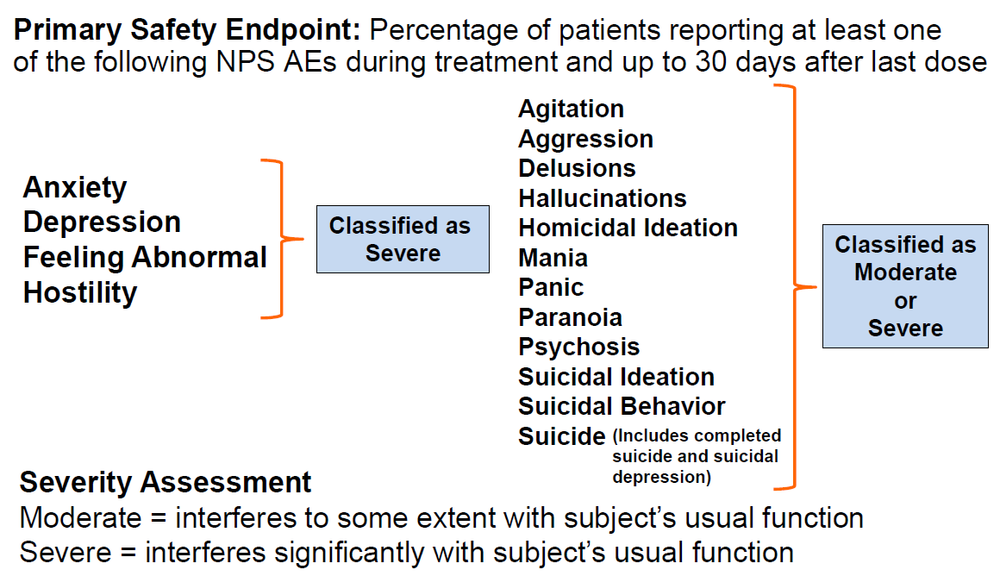
EAGLES Adverse Events

Slide 29
Safety: EAGLES
Safety- Characterize the neuropsychiatric events as a function of treatment, psychiatric disorder and the interaction of treatment and psychiatric disorder.
Interpretation- No significant increase in neuropsychiatric adverse events attributable to varenicline or bupropion relative to nicotine patch or placebo.

Slide 30
Safety: Prospective Cohort Study
Design- Electronic Medical Records from 654 practices
Sample- 235,314 (159,736 NRT; 75,578 varenicline)
Interpretation- Varenicline was generally associated with decreased or similar odds of depression or anxiety compared to NRT.
(Taylor et al., 2020)
Notes:
Taylor GMJ, Itani T, Thomas KH, et al. Prescribing Prevalence, Effectiveness, and Mental Health Safety of Smoking Cessation Medicines in Patients With Mental Disorders. Nicotine Tob Res. 2020;22(1):48-57. doi:10.1093/ntr/ntz072

Slide 31
Safety: Systemic Reviews and Meta-Analyses
Design- Systematic reviews and Bayesian network meta-analyses of RCTs
Sample- 363 trials for effectiveness and 355 for safety
Interpretation- (1) No evidence of increasing MACEs compared to placebo or each other. (2) No strong evidence that varenicline increased SAEs. (3) But increased odds of MANEs for varenicline compared to bupropion. (4) Evidence that bupropion increased odds of SAEs compared to placebo.
Thomas et al., 2021
Notes:
Thomas KH, Dalili MN, López-López JA, Keeney E, Phillippo DM, Munafò MR, Stevenson M, Caldwell DM, Welton NJ. Comparative clinical effectiveness and safety of tobacco cessation pharmacotherapies and electronic cigarettes: a systematic review and network meta-analysis of randomized controlled trials. Addiction. 2021 Oct 11. doi: 10.1111/add.15675. Epub ahead of print. PMID: 34636108.

Slide 32
Clinical Implications
Notes:
There is a cost benefit analysis that is needed generally and individually for any medication- which is a mix of how effective the drug is and how safe it is.
Lets look separately at effectiveness and safety and then with this combined knowledge what the clinical implications are–

Slide 33
Expert Panel Recommendations
Strong Recommendations Include
Using varenicline rather than a nicotine patch
Using varenicline rather than bupropion
Using varenicline rather than a nicotine patch in adults with a comorbid psychiatric condition
Initiating varenicline in adults even if they are unready to quit
Extending treatment duration to greater than 12 weeks.
Conditional Recommendations Include
Combining a nicotine patch with varenicline rather than using varenicline alone
Using varenicline rather than electronic cigarettes.
Leone et al., 2020
Notes:
Leone FT, Zhang Y, Evers-Casey S, Evins AE, Eakin MN, Fathi J, Fennig K, Folan P, Galiatsatos P, Gogineni H, Kantrow S, Kathuria H, Lamphere T, Neptune E, Pacheco MC, Pakhale S, Prezant D, Sachs DPL, Toll B, Upson D, Xiao D, Cruz-Lopes L, Fulone I, Murray RL, O'Brien KK, Pavalagantharajah S, Ross S, Zhang Y, Zhu M, Farber HJ. Initiating Pharmacologic Treatment in Tobacco-Dependent Adults. An Official American Thoracic Society Clinical Practice Guideline. Am J Respir Crit Care Med. 2020 Jul 15;202(2):e5-e31. doi: 10.1164/rccm.202005-1982ST. PMID: 32663106; PMCID: PMC7365361.

Slide 34
The 5As
ASK
ADVISE
ASSESS
ASSIST
ARRANGE

Slide 35
Treatment Intervention Model
(1) Prescribe FDA-approved pharmacotherapy
First-line treatment
Varenicline or
Combination of nicotine replacement products (patch + choice of lozenge, gum, inhaler, or nasal spray as needed to control cravings)
(2) If patient preference or first-line treatment intolerance or contraindication
Second-line treatment
Single nicotine replacement product (patch, lozenge, gum, inhaler, or nasal spray) or
Bupropion
(3) If single agent is not sufficient to achieve abstinence
Consider combining categories of FDA-approved drugs
Varenicline + nicotine replacement product
Varenicline + bupropion
Bupropion + nicotine replacement product
Rigotti et al., 2022
Notes:
Rigotti NA, Kruse GR, Livingstone-Banks J, Hartmann-Boyce J. Treatment of Tobacco Smoking: A Review. JAMA. 2022;327(6):566–577. doi:10.1001/jama.2022.0395

Slide 36
Cross-Cutting Interventions
Cognitive Behavioral Therapy and Variants
Motivational Enhancement
Contingency Management

Slide 37
Current Considerations

Slide 38
Chantix Recall
Chantix is currently unavailable
July- Sept 2021 recall- to include all lots of Chantix due to the presence of a nitrosamine impurity above the FDA’s acceptable daily intake limit.
Long-term use of impure product use- increased cancer risk
Notes:
FDA updates and press announcements on nitrosamine in varenicline (Chantix). News release. US Food and Drug Administration. Accessed September 17, 2021. https://www.fda.gov/drugs/drug-safety-and-availability/fda-updates-and-press-announcements-nitrosamine-varenicline-chantix.
Pfizer expands voluntary nationwide recall to include all lots of Chantix® (varenicline) tablets due to N-nitroso varenicline. News release. Pfizer. September 16, 2021. Accessed September 17, 2021. https://cdn.pfizer.com/pfizercom/2021-09/Press-Release-Chantix-All-Lots-16SEP21.pdf?JTi.179qjytJBu2MVYPYt.dWuN8ic5Vx.
Beard, J., & Swager, T. (2021). An organic chemist’s guide to N-nitrosamines: Their structure, reactivity, and role as contaminants. The Journal Of Organic Chemistry.
Bharate, S. (2021). Critical analysis of drug product recalls due to nitrosamine impurities. Journal Of Medicinal Chemistry.

Slide 39
Varenicline Availability
Patent protection for Chantix expired in May 2020
Par Pharmaceutical’s varenicline product was approved by FDA on August 11, 2021
Apotex is distributing Apo-Varenicline, a Canadian-approved drug product, under FDA's temporary exercise of regulatory flexibility and discretion
Notes:
FDA updates and press announcements on nitrosamine in varenicline (Chantix). News release. US Food and Drug Administration. Accessed September 17, 2021. https://www.fda.gov/drugs/drug-safety-and-availability/fda-updates-and-press-announcements-nitrosamine-varenicline-chantix.
Pfizer expands voluntary nationwide recall to include all lots of Chantix® (varenicline) tablets due to N-nitroso varenicline. News release. Pfizer. September 16, 2021. Accessed September 17, 2021. https://cdn.pfizer.com/pfizercom/2021-09/Press-Release-Chantix-All-Lots-16SEP21.pdf?JTi.179qjytJBu2MVYPYt.dWuN8ic5Vx.
Beard, J., & Swager, T. (2021). An organic chemist’s guide to N-nitrosamines: Their structure, reactivity, and role as contaminants. The Journal Of Organic Chemistry.
Bharate, S. (2021). Critical analysis of drug product recalls due to nitrosamine impurities. Journal Of Medicinal Chemistry.

Slide 40
Coverage & Billing
www.Lung.org/CessationCoverage

Slide 41
Future Possibilities

Slide 42
Cytisine
Similar to varenicline but found to have fewer side effects
Marketed as Tabex
Has demonstrated efficacy
Very low cost
A US randomized trial began in 2020
Notes:
Recent Phase III clinical trials using Tabex have shown similar efficacy to varenicline but at a fraction of the cost. A 2011 study found cytisine improved 12-month abstinence from nicotine from 2.4% with placebo to 8.4% with cytisine (West et al., 2011). A 2013 meta-analysis of eight studies demonstrated that cytisine has similar effectiveness to varenicline but with substantially lower side effects (Hajek et al., 2013).
The largest trial to date held with cytisine was performed in 2014. Cytisine was found to be superior to nicotine-replacement therapy in helping smokers quit smoking when combined with brief behavioral support. However, it was associated with a higher frequency of self-reported adverse events (Gómez‐Coronado et al., 2018).
In the US, a randomized trial to inform a possible future application of cytisine for FDA approval began in 2020 (NCT04576949).

Slide 43
Making the Case

Slide 44
Behavioral Causes of Death in US
* Persons with BH conditions
500,000
480,000
HIV/AIDS
5,698
400,000
392,568
Homicide
19,510
Tobacco
Alcohol
35,823
300,000
MVAs
40,231
Suicide
47,173
200,000
*
Drug-Induced
73,990
Weight-Related
170,143
100,000
Notes:
Training Notes:
This data comes from the Centers for Disease Control and shows the annual number of deaths by cause of death. The tobacco-related deaths include deaths from cancer, cardiovascular diseases, diabetes, respiratory diseases, perinatal conditions (prenatal and SIDS) and secondhand smoke (USDHHS, 2014).
Obesity – 170,143 Source: Tobias, D.K., Hu, F.B., (2018). The association between BMI and mortality: implications for obesity prevention. The Lancet. 6: 916-917.
Drug-induced – 67,625
Suicide – 44,965
Motor vehicle accidents – 40,327
Alcohol-induced – 34,865
Homicide – 19,362
HIV/AIDS – 6,160
Source: Xu, J., Murphy, S.L., Kochanek, K.D., Bastian, B., Arias, E. (2018). Deaths: Final Data for 2016. National Vital Statistics Reports. 67(5). United States Department of Health and Human Services. Hyattsville, MDL National Center for Health Statistics. Source: https://www.cdc.gov/nchs/data/nvsr/nvsr67/nvsr67_05.pdf

Slide 45
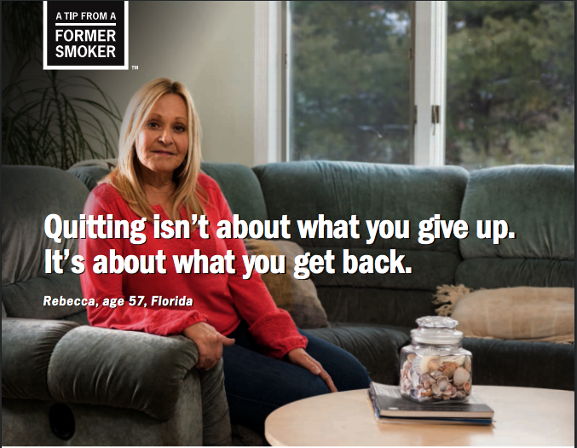
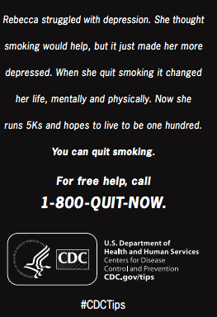
Quitting: It Can Be Done
Persons with behavioral health conditions:
Are able to quit using
75% want to quit using
65% tried to quit in the last 12-months

Slide 46
Comments & Questions?
Questions?
Notes:
Thank you, Chad, for an incredible presentation today! We will now open the floor for Q&A. As a reminder, you may submit questions through the chat box or Q&A panel on your Zoom dashboard
[Question and answer session – Hope moderates]

Slide 47
Behavioral Health & Wellness Program
303.724.3713
bh.wellness@ucdenver.edu
www.bhwellness.org
Behavioral Health and Wellness Program
BHWP_UCD

Slide 48
Thank you for joining us!
Please be sure to complete the brief post-webinar evaluation.
Visit BHtheChange.org and Become a FREE Member Today!
Notes:
Thank you all so much for joining us today. Just a quick reminder to please take a few moments to fill out the post-webinar survey that will pop up on your screen momentarily.
I also want to remind everyone that the recording and presentation slides from this webinar will be available for download on our website at BHtheChange.org.
Thank you so much and have a great rest of your day!

