Slide 1
National Behavioral Health Network for Tobacco & Cancer Control:​
Virtual Coffee Chat
Managing the Psychological and Psychosocial Effects of a Cancer Diagnosis
September 21, 2018, 2:00 PM ET

Slide 2
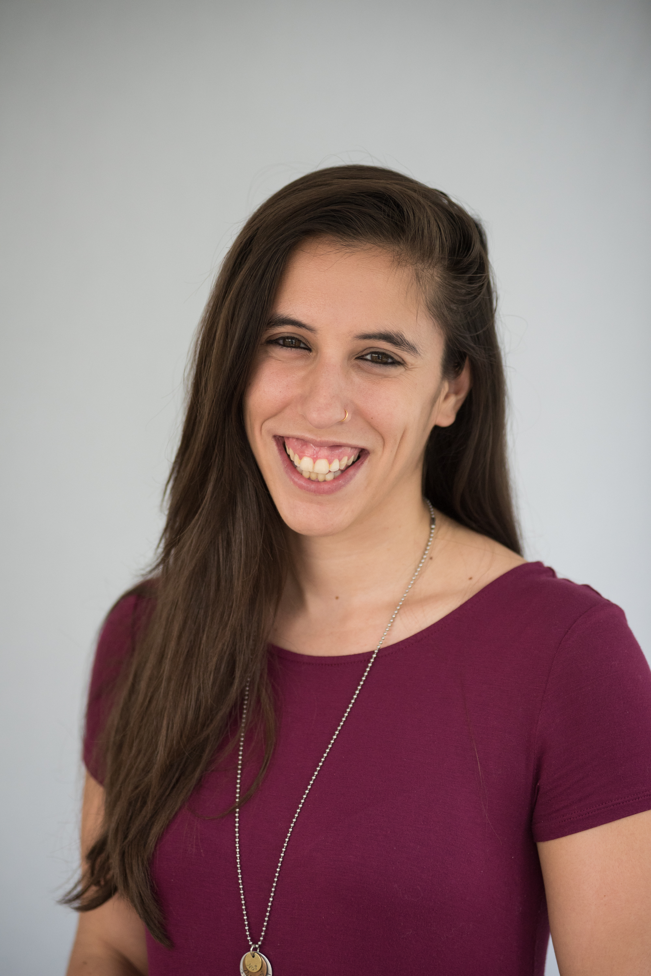

Welcome!
Sarah Linden
Project Coordinator, Policy & Practice Improvement
National Behavioral Health Network for Tobacco & Cancer Control
National Council for Behavioral Health
SarahL@thenationalcouncil.org

Slide 3
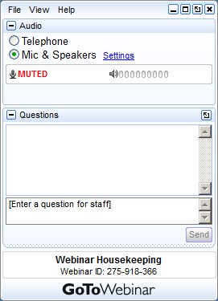

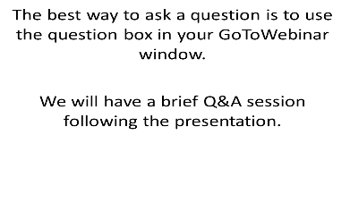
Housekeeping
1. Turn off or mute your
computer speakers.
2. GoToWebinar INSTRUCTIONS:
Join the webinar: https://attendee.gotowebinar.com/register/6542986278252584963
Call in using your telephone: +1 (415) 655-0060
Access Code: 477-365-819
Audio PIN: Shown after joining the meeting
Please do the following two steps.
Please be sure to enter your unique audio pin so that we can unmute you!

Slide 4






Visit www.BHtheChange.org and
Join Today!
Jointly funded by CDC’s Office on Smoking & Health & Division of Cancer Prevention & Control
Provides resources and tools to help organizations reduce tobacco use and cancer among people with mental illness and addictions
1 of 8 CDC National Networks to eliminate cancer and tobacco disparities in priority populations
Free Access to…
Toolkits, training opportunities, virtual communities and other resources
Webinars & Presentations
State Strategy Sessions
Communities of Practice
#BHtheChange

Slide 5
Agenda
Welcome and Introductions, Rachel Landefeld, MPA, Strategic Management Services, LLC
Managing the Psychological and Psychosocial Effects of a Cancer Diagnosis in Behavioral Health Drucilla Brethwaite, MSW, LCSW, Inova Life with Cancer, Inova Schar Cancer Institute
Integrated Mental Health and Cancer Care for Individuals with Serious Mental Illness, Kelly Irwin, MD, Massachusetts General Hospital Cancer Center, Director, the Collaborative Care and Community Engagement Program
Q & A
Wrap-up

Slide 6
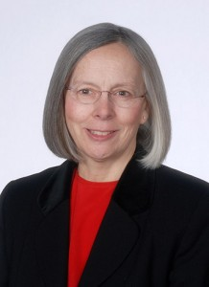
Drucilla Brethwaite, MSW, LCSW - Director, Inova Life with Cancer, Inova Schar Cancer Institute
Drucilla is the Director of the Inova Life with Cancer Family Center. She oversees the delivery of programs, processes, and procedures for patients and families at the Center. In addition, she continues to provide counseling to individuals, couples, and families to promote adjustment to illness and improved quality of life.
Areas of interest include couples, insomnia, mind-body wellness, survivorship issues, caregivers, resiliency, end of life, and grief/bereavement. In collaboration with colleagues, she has helped create psychoeducational programs on Exploring Mind-Body Techniques, Tools for Couples Facing Cancer, Insomnia, Crafting a Legacy, Maintaining Resiliency, and Managing Anger. Drucilla co-facilitates a number of groups.

Slide 7

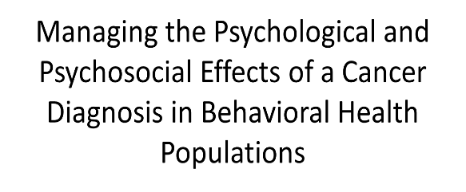
Drucilla Brethwaite, Director, Inova Life with Cancer
drucilla.brethwaite@inova.org

Slide 8


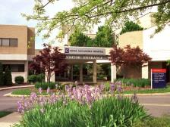

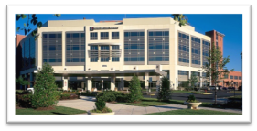

Inova Schar Cancer Institute
Inova Life with Cancer Family Center

Slide 9

A Unique Model
Psychosocial arm of Inova Schar Cancer Institute
Funded by the community
FREE resource regardless of where treated
Comprehensive, evidence-based programming
Adults and children
Staffed by more than 40 clinicians
Oncology Clinical Therapists
Oncology Nurse Navigators
Psychiatrist (Psycho-oncologist)
Oncology Dietician Clinical Specialist
Exercise Trainers
Contractors

Slide 10
Psychological & Psychosocial Effects
Medical Education
Counseling
Adjustment
Anxiety
Depression
Insomnia
Sexual health
Relationships
Posttraumatic stress
Bereavement
  Diagnosis
  Treatment/Procedures
  Medications
  Side effects
  Clinical trials
  Nutrition

Slide 11
Assessments
Chronic Illness Distress Scale (CIDS)
Brief Symptom Inventory-18 (BSI-18)
Patient Health Questionnaire (PHQ-9)
General Anxiety Disorder 7 (GAD 7)
Cancer Coping Questionnaire
MD Anderson Symptom Assessment (MDASI)
Insomnia assessments
Cognitive assessments

Slide 12

Interventions
Individual, couples and family counseling (adults and children)
Support groups
Psychoeducational classes
Psycho-oncologist
Acupuncture
Art therapy
Education (oncology nurse navigators)
Nutrition
Fitness
Wellness classes

Slide 13
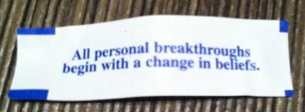

Counseling
Cognitive Behavioral Therapy
Meaning Centered Psychotherapy
Mindfulness
Crisis Intervention
Play Therapy
Sand Tray
Art Therapy
Grief Counseling

Slide 14
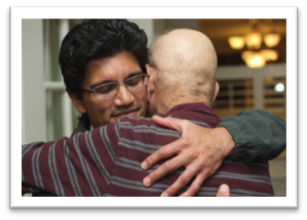
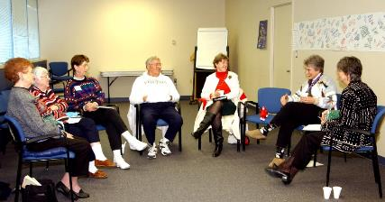
Groups
Disease specific
Advanced Disease
Survivorship
Young Adult
Caregivers
Spirituality

Slide 15
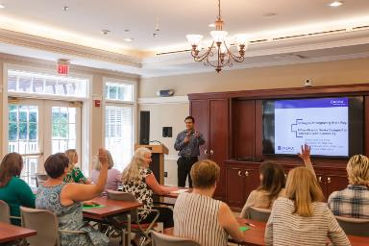
Psychoeducational Classes
Strategies for Managing Insomnia
Cancer Related Cognitive Impairment
Tools for Couples
Mind Over Matter
Mindfulness Based Cancer Recovery
Compassion Cultivation
Meaning Centered Psychotherapy
Strategies for Resilience
Crafting your Legacy
Feeling Irritable
Fatigue
Pain Management
Meditation/mindfulness
Grief
Children/Teens Programs

Slide 16
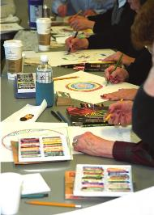
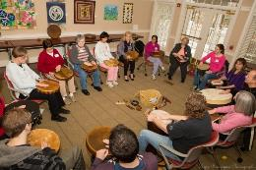

Healthy Living & Stress Management
Fitness
Expressive Arts
Yoga
Meditation & Guided Imagery
Qi Gong / Tai Chi
Zumba
Reiki
Writing for Wellness
Therapeutic Journaling
Therapeutic Dance
Knitting
Massage
Acupuncture
Drumming

Slide 17
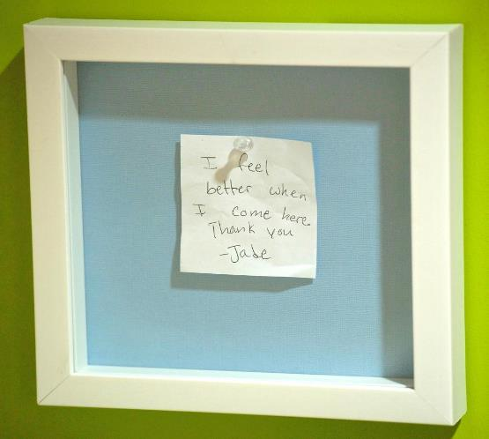

Slide 18
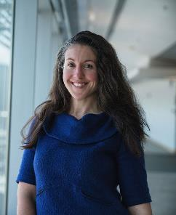
Kelly Irwin, MD, Massachusetts General Hospital Cancer Center:
Dr. Irwin is an instructor in psychiatry at Harvard Medical School and a faculty psychiatrist at the Massachusetts General Hospital (MGH) Cancer Center and MGH Schizophrenia Program. She is the founding director of the Collaborative Care and Community Engagement Program, a clinical and research program dedicated to improving cancer outcomes for individuals with serious mental illness.
Dr. Irwin investigates why people with severe mental illness including schizophrenia and bipolar disorder are more likely to die from cancer and develops interventions to improve cancer outcomes throughout the continuum of cancer care.

Slide 19
BRIDGING THE DIVIDE:
Integrated Mental Health and Cancer Care for Individuals with Serious Mental Illness
Kelly Irwin, MD, MPH
Instructor in Psychiatry, Harvard Medical School
Director, Collaborative Care and Community Engagement Program
Mass General Hospital Cancer Center
Consultant, Massachusetts Department of Mental Health

Slide 20
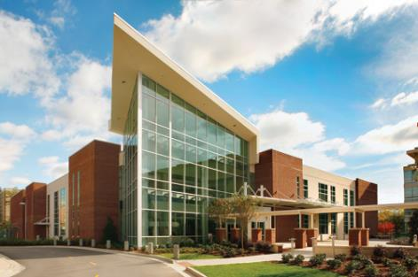
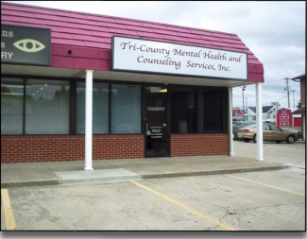
Cancer Center
Mental Health Clinic

Slide 21
What is my life expectancy?
A Woman in Massachusetts
82

Slide 22
What is my life expectancy?
A Woman in Massachusetts
82
…with Serious Mental Illness served by Department of Mental Health
52

Slide 23
Inequities in cancer treatment contribute to premature cancer mortality and increased suffering for patients with serious mental illness.
Prevention & screening
Diagnosis
Treatment
Surveillance
End-of-life care
Delay to diagnosis
Delay to treatment
Deviations from stage-appropriate treatment & trials
Loss to follow-up
Less access to palliative care
Bergamo, C. et al, Psychosom Med, 2014
Kisely, S., et al, JAMA Psychiatry, 2013
Abudullah KN, et al, Am J Surg, 2015
Chan et al, BMJ Open, 2014, Foti, Psychiatric Services, 2005, Huang, BMJ, 2017, Chochinov, 2012
Notes:
- Lower rates of breast-conserving treatment vs. mastectomy
Lower rates of chemotherapy and radiation for many cancers
More research needed to identify which patients vulnerable to poor outcomes

Slide 24
Cancer and serious mental illness: The research and clinical challenge of high-complexity acute illnesses
The Four Quadrant Model of Integrated Care
High
Treated in behavioral health home
?
Need for a new model
Psychiatric Illness Severity
Low
Treated in primary care setting
Specialty medical consultation
Low
High
Medical Illness Severity
http://www.integration.samhsa.gov/clinical-practice,accessed 4.11.15

Slide 25
Bridge: Intensive Collaborative Care for SMI and Cancer
Diagnosis
Consultation
Navigation
Collaboration
Caregiver
Patient
Caregiver
Patient
Caregiver
Patient
Caregiver
Patient
Onc.
Onc.
Onc.
Case Manager
Onc.
Case Manager
Psy
Psy
Psy
Consulting psychiatry leads to integrated treatment plan addressing cancer and mental illness
Involving a case manager promotes coordination of care, allows flexibility, and helps to prevent care disruptions
Interdisciplinary collaboration leads to improved cancer outcomes
Irwin et al, NEJM, 2016
Notes:
Discuss what we did in this case and how it might be extended/disseminated acknowledging differences in resources and access to services in different systems of care. (always have a patient and an oncologist)

Slide 26
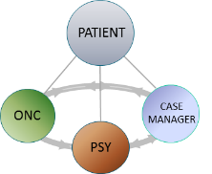
The Bridge intervention was feasible and there was significant unmet need.
Goal | Result
Enroll 30 patients in 15 months | 30 patients enrolled in 4 months
50% of approached patients consent to enroll in study | 90% of eligible patients consented
75% of enrolled patients complete all assessments | 100% had comprehensive assessment 88% completed all self-report measures
5/6 patients who previously declined cancer treatment received all recommended cancer care during the pilot study.

Slide 27
Collaborative Care and Community Engagement Program
Mission: To promote equity in cancer care for people affected by mental illness and their caregivers through patient-centered research, clinical innovation, education, and advocacy
RESEARCH Randomized trial investigating impact on cancer care
CLINICAL Patient-centered team care, Continuity across settings,
Consultation to community-based clinicians
EDUCATION Cancer and Mental Health Collaborative
& ADVOCACY Bridging the Divide Symposium: April 11th and 12th
@endtheinequity, @Kelly_IrwinMD

Slide 28
Cancer and Mental Health Collaborative
Our Mission
People with mental illness are often NOT seen. Being invisible contributes to dying earlier and more frequently from cancer. We need to open our eyes and work together to bridge the divide between cancer and mental health to save lives and decrease suffering.
We are building a community network that engages diverse voices to promote equity in cancer care and research. We commit to:
Make mental illness visible through education and advocacy
Increase access to timely, high quality, integrated mental health and cancer care
Improve the cancer care experience and health outcomes for individuals with mental illness and their caregivers
Conduct and disseminate research that matters to patients, caregivers, and clinicians
Improve our healthcare system through targeted policy change

Slide 29

Join us!
Scholarships to attend will be available!
To join the collaborative, please email we.bridge.the.divide@gmail.com
Follow us on Twitter @EndtheInequity @Kelly_IrwinMD

Slide 30
Thank you
The patients, families, caregivers, and clinicians
Our clinical and research team: Amy Corveleyn, Cat Callaway, Lauren Fields
My mentors: William Pirl, Elyse Park, Joseph Greer, David Ryan, Oliver Freudenreich, Donna Greenberg, Andrew Nierenberg
The MGH Cancer Outcomes Research Program
Generous supporters
  The Massachusetts Department of Mental Health
  Harvard Risk Management Foundation (CRICO)
  Program in Cancer Outcomes Research Training
  MGH Cancer Center
  Dana-Farber Harvard Cancer Center
  MGH Psychiatry and Leadership Council
  American Cancer Society
  Joan and Henry Archibald, Joe Malouf
  Patient-Centered Outcomes Research Insitutute Engagement Awards

Slide 31
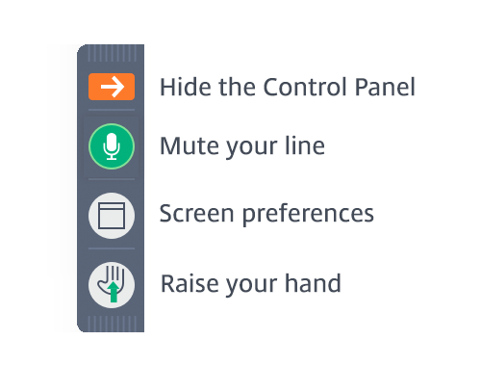
Q&A
Have a question for one of our presenters? You can ask in one of two ways:
Type your question into the Questions dialogue box on the right side of your screen.
Raise you hand using the “Raise Hand” icon next to the Questions dialogue box.
Be sure to enter your AUDIO PIN so that we can unmute you!

Slide 32
Wrap-Up & Reminders
Evaluations
Recording availability
Visit https://bhthechange.org for more information.

Slide 33
THANK YOU!

